Slide 1
Managing
Time For Speed and Prioritization
Prof. Parul Rishi PhD (Psychology)
Associate Profssor,Faculty of Human Resource Management
Adjunct Professor-Management- University of Zululand, South Africa
Expert Consultant - Environmental Psychology
Aix Marseille University , France
drparulrishi@gmail.com

Slide 2
Time vs. Success
Being successful doesn’t make you manage your time well.
Managing your time well makes you successful.

Slide 3
The Problem of Managing Time
By some estimates, people waste about 2 hours per day due to following:
  Messy desk and cluttered files
  Can’t find things
  Un prepared,
  Try to do things which other people should do
  Tired/unable to concentrate

Slide 4
Major functions of Judicial Administration
Judicial Record Management
Lok Adalat
RTI
Coordination among different courts
Issuance of Cause List
Index Delivery

Slide 5
The 80/20 Rule
Good administration in judiciary system comes from time and experience
And having the Art of identifying trivial vs critical case details and accordingly providing time.
Critical witness/case details are few (20%) and the trivial distracting unnecessary details are many(80%).
So time spent should be reverse ,i.e, 80% on 20% critical details and 20% on 80% trivial details .
However, in practice, it is reverse.

Slide 6
80/20 of Judicial Administration

Slide 7
From Reasonable Time to Optimal Time Frame
CASES ARE MANAGED AND DISPOSED IN DUE TIME
Without any Undue Delay
Time line of Judicial Proceedings
Without Compromising the Quality and Fairness of Judgment

Slide 8
Tools to Measure Time Management
Quantify Delays
How Much Delay?
Causal Analysis of Delays
Whether causes unavoidable/ Avoidable?
Who is accountable for delay?
Accountability for delay
Person- Lawyer/Witness/ Prosecutior/Judge/Adm Personnel/Police/etc.
Situation
Why Delay?

Slide 9
How to Manage Time???
Time
Planning
through
Time
Frames
for
Timely
Justice

Slide 10
What is Time Frame???
Tools to achieve the timeliness of case processing.
A condition to start measuring and comparing case processing delays
  - a difference between the actual situation and the expected timeframes implemented to reduce the lengths of case processing.
Timeframes have to fit the contingencies of the “local legal culture
Having timeframes is a prerequisite for evaluating the results of the efforts made to improve the lengths of judicial proceedings.

Slide 11
Timeliness of Case Processing
Setting realistic and measurable time frame for every case
Enforcing Time Frame
Monitoring Time Frame

Slide 12
How Time Framing Helps???
Time Framing goals should be shared and pursued by all though stakeholders’ participation
To Help Build Common Commitment among Key Players
To Help Build Environment for Development of Innovative Policies
Help Build the culture of Shared responsibilities rather than blame game
CONSIDERING THE LOCAL LEGAL CULTURE

Slide 13
Attributional Style
Internal
External

Slide 14
External LOC for Delay in case processing/Judgment Delivery
Population
So many cases per day
Staff do not cooperate
Outside pressures
Legal system takes time , its ok
System is like that
Being Meticulous is an indicator of Quality

Slide 15
Internal LOC of Delay
Inspite of all odds, I can still make a try to improve the system
It is my responsibility to handle the staff in a way that delay can be avoided
I must monitor stringently to avoid delay, at least on my part and facilitate others to speed up.
People should not mock judiciary for delay.I must find some solution

Slide 16
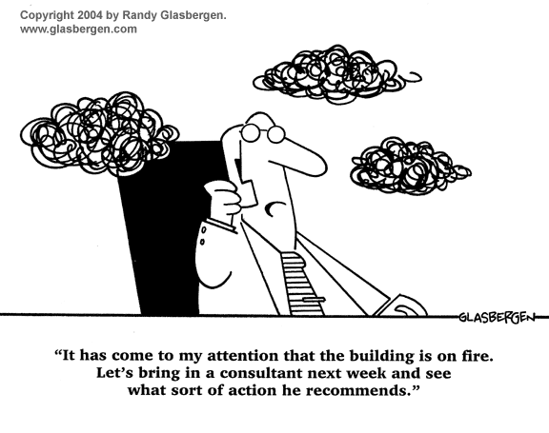

Slide 17
Examples of Time Framing Across the world
Finland- Optimum timeframes for each type of cases are agreed and Targets for case processing are set.
Slovenia - court rules sets a timeframe of 18 months after the case has been presented before the court. If a decision is not taken within 18 months, the case is considered delayed. The head of court may ask the judge in charge of the case to report the circumstances why a decision has not been reached.
Sweden − targets for civil and criminal cases are set up by the Government. All units within the court define their targets

Slide 18
Setting of timeframes for kind of procedure
Timeframes make more sense if they are set up allowing for the different kinds of procedure (civil, criminal, administrative, enforcement, etc.).
Denmark− 58% of the civil cases should be disposed within 1 year, 63% of the criminal cases should be disposed within 2 months and 95% within 6 months.
Norway − Timeframes are proposed by the Ministry of Justice with consent from the Norwegian Parliament. As of today, 100% of civil cases should be disposed in six months, 100% of criminal cases in three months.

Slide 19
Setting timeframes in collaboration with justice stakeholders
The building and maintenance process of setting realistic timeframes must involve the stakeholders at the different levels (state, court, single unit).
Setting timeframes is not a once for all event, but it has to be a continuous process built through consensus and shared objectives between the stakeholders.

Slide 20
Examples
Finland − there is a tailored program for each case and directions are given informing the parties about the estimated timeframe of the pre-trial phase, pre-trial hearings and trial.
Detailed hearing timetables are sent beforehand to the parties. The lawyers and prosecutors are copied in for comments.
Several discussions take place between the judges and the local lawyers in order to come up with common ideas and guidelines on how to improve the efficiency of justice including the length of procedure.
Germany − regular meetings with lawyers are organised to discuss customer satisfaction and problems with the service delivered by the court.
Sweden − timeframes for each civil case are setting up in cooperation with the users.

Slide 21
Alexander says
“ If there is a path ,I will find it.
If there is no path, I will make it.”

Slide 22
Live Above the LINE-
Covey’s Time Management Matrix
Important
Not important
MANAGE Crisis Critical Pressing Cases Deadline driven Cases Meetings DO IT NOW | AVOID Diverging papers/reports/witness Interruptions, Phone calls Media Interventions DELEGATE
FOCUS Complex Cases Having long term implications and can create precedence DECIDE WHEN TO DO | LIMIT Time Wasters Disturbances Unwanted people Unrelated details to confuse DUMP
1
2
Urgent
Not
Urgent
3
4

Slide 23
Important
Not important
Urgent
MANAGE DO IT NOW | AVOID DELEGATE
FOCUS DECIDE WHEN TO DO | LIMIT DUMP
Not
Urgent

Slide 24
Priority Listing
A
B
C
of Time Management

Slide 25


Slide 26
How to Get IT Done
20 minutes at beginning of week
  Review your Roles
    Sharpen the Saw –Read and analyse before hand to save time
  Prioritize by Choosing Big Rocks first
    Which is the most important case requiring maximum time and effort?
  Schedule the Week keeping in mind the reversal of 80/20 Rule
Notes:
FFA needs to Plan Weekly!!!

Slide 27

Get it All Done
Peter Drucker says:
Work where you are the strongest 80% time
Work where you are learning 15 % time
Work where you are the weakest 5% time

Slide 28
Scheduling Yourself
You don’t find time for important things, you make it
Everything you do is an opportunity cost
Learn to say “No”

Slide 29
PD Time
Precious Time
Dead Time

Slide 30
Cutting Things Short
“I’m in the middle of something now…”
Start with “I only have 5 minutes” – you can always extend this
Stand up, stroll to the door, complement, thank, shake hands
Clock-watching; on wall behind them

Slide 31
Using Time Journal Data
What am I doing that doesn’t really need to be done?
What am I doing that could be done by someone else?
What am I doing that could be done more efficiently?
What do I do that wastes others’ time?

Slide 32
Delegation
No one is an island
You can accomplish a lot more with help
Most delegation in your life is from faculty to graduate student

Slide 33
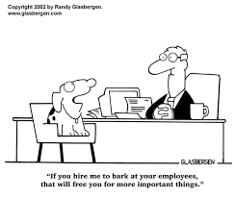

Slide 34
Procrastination
“Procrastination is the
thief of time”
Edward Young
Night Thoughts, 1742

Slide 35
Avoiding Procrastination
Doing things at the last minute is much more expensive than just before the last minute
Deadlines are really important: establish them yourself!

Slide 36
Balancing Act
“Work expands so as to fill the time available for its completion”
Parkinson’s Law
Cyril Parkinson, 1957

Slide 37
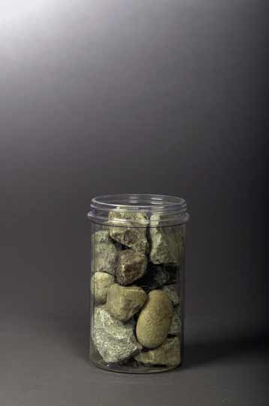
Is The Jar Full?
Stephen Covey in his book, First Things First, shares the following story
"How many of these rocks do you think we can get in the jar?" he asked.

Slide 38
After many guesses, he said, "Okay, Let's find out."
He set one rock in the jar . . . then another . . . then another.
I don't remember how many he got in, but he got the jar full.
Then he asked, "Is this jar full?"
Everyone looked at the rocks and said, "Yes."

Slide 39
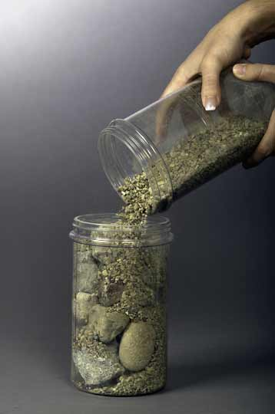
Then he said, "Ahhh" He reached under the table and pulled out a bucket of gravel.
Then he dumped some gravel in and shook the jar and the gravel went in all the little spaces left by the big rocks.
Then he grinned and said once more, "Is the jar full?"

Slide 40
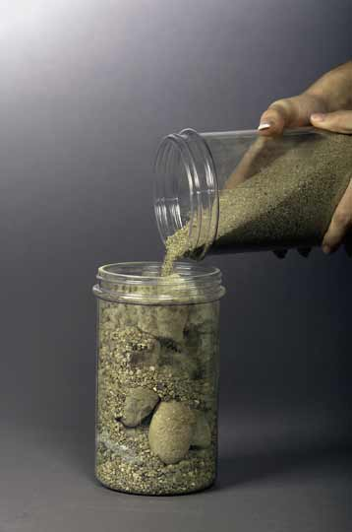
"Probably not,”
He reached under the table and brought out a bucket of sand. He started dumping the sand in and it went into all of the little spaces left by the rocks and the gravel.
Once more he looked and said, "Is this jar full?" "No!" we roared.

Slide 41
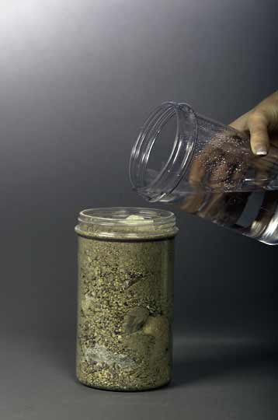
He said, "Good!" and he grabbed a pitcher of water and began to pour it in.
" Well, what's the point?"
Somebody said, "Well, there are gaps, and if you work really hard you can always fit some more things into your life."

Slide 42
"No," he said, "that's not really the point.
The point is this:
Put the
Big Rocks
in First

Slide 43
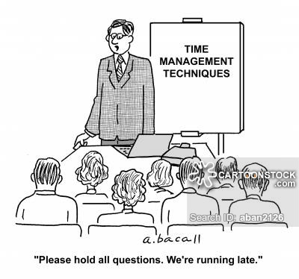

Slide 44
Thank you
Have a Relaxed Time
Today & For Ever!

